Slide 1

Predictive Analysis of Oil and Gas using Well Log Data
Vraj Desai
60003200182
Aayushi Waghela
60003200165
Rujuta Joshi
60003200157
Under the guidance of
Prof. Prachi Tawde
Project Guide
Department of Information Technology
DJSCE
Mumbai University
2022-23

Slide 2
Overview
Problem Definition
Revised System Architecture
Implementation demonstration
Remaining work with timeline
References/Learning resources.
References

Slide 3
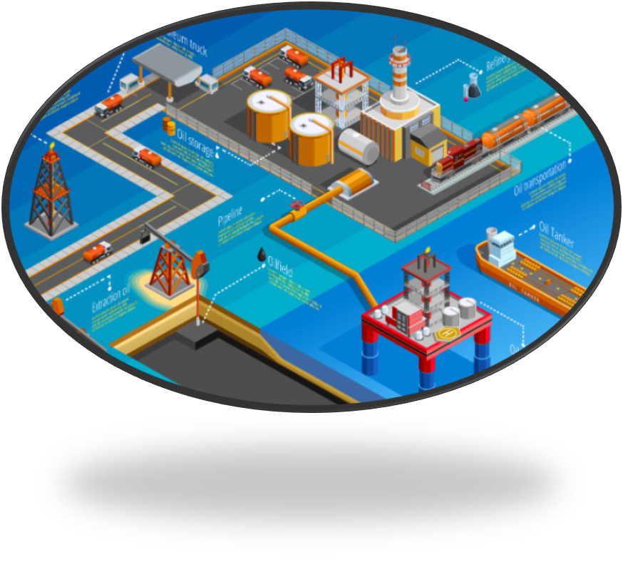
Problem Definition
Prediction of presence of oil and gas facies and its classification from well logs is one of the major challenging tasks in the oil and gas industry. With regard to each reservoir prediction, it requires a tremendous amount of time and resources.
The proposed technique predicts the existence of the facies for oil and gas mining employing various machine learning and data mining algorithms.
The system's foundation is the facies categorisation enabled by well logs, along with a number of physical variables intended to reduce the prescribed prediction error functions. In this study, we use various machine learning and deep learning models to accurately predict and speed up the prediction of presence of facies in an attempt to tackle these problems.

Slide 4
Revised System Architecture
Encoding Feature and target Variable
(Label Encoder)
Hyper Parameter Tuning
Random Forest Classifier
Presence of oil and Gas prediction
(Model Testing on new dataset
Home Page
(Basic Facts about Dataset)
EDA (Exploratory Data Analysis)
Feature Relationships
(Scatter plots, Histograms)
Auto-ML
Regression and Classification
(Comparison table of different algorithms)
Predictive Analysis (Model Training)
Data Cleaning
(Missing values, Outlier Detection)
https://whimsical.com/getting-started-boards-17m9LsxyxA8Z9LBGULv2Y3

Slide 5
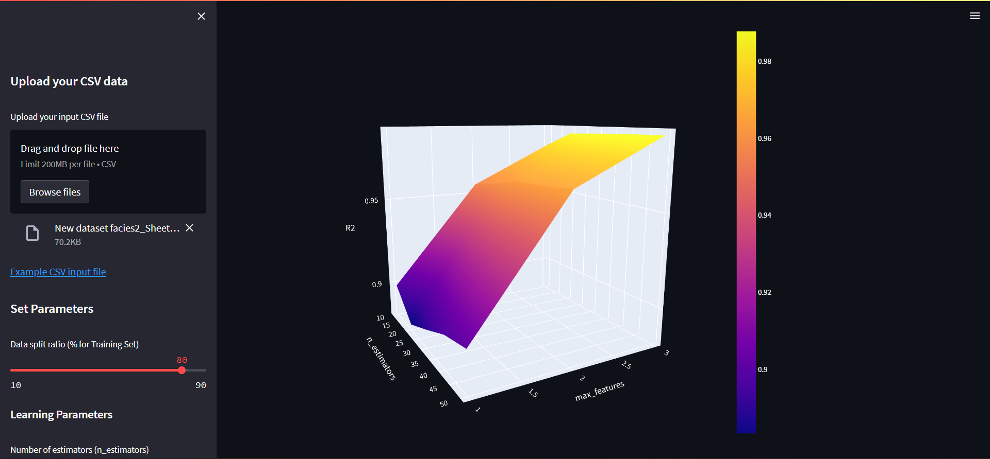
Implementation Demonstration
DataSet: D:\IPD\IPD-master (1)\IPD-master\apps\datasets\WELL_LOG_MAIN_DATASET.csv
New DataSet: D:\IPD\IPD-master (1)\IPD-master\apps\datasets\WELL_LOG_SECONDARY_DATASET.xlsx

Slide 6
Remaining work with timeline
1 May
Neural Network improve accuracy
Predictive analysis of top 5 regression algorithms
15 April

Slide 7
References/Learning Resources
Link : D:\IPD\IPD-master (1)\IPD-master\Literature review.docx
Title | Year Of Publication | Algorithm Used | Advantages | Drawbacks
1) Deep residential representations: Using unsupervised learning to unlock elevation data for geo-demographic prediction | 2022 | 1) Linear least-squares Model (LM) 2) non-linear Gradient Boosting Machine (GBM). | Both embedding approaches using Deep Learning can yield improved RMSE results across all the domains, when used in conjunction with the other demographic features, the performance is notably improved using the SimCLR approach with performance uplifts of up to 21%. | Larger models may reasonably lead to even better performance. Other clustering approaches may potentially produce better clusters.

Slide 8
References/Learning Resources
Title | Year Of Publication | Algorithm Used | Advantages | Drawbacks
2) Application of machine learning, deep learning and optimization algorithms in geoengineering and geoscience: Comprehensive review and future challenge | 2022 | (1) the ML methods including the supervised, unsupervised and semi-supervised learning algorithms (2) the DL methods including AE, DBN, CNN, RNN, LSTM (3) OA techniques, including the conventional Stochastic Gradient Descent, Conjugate Gradient, and the Evolutionary Algorithms, the Novel Swarm intelligence optimizations | Strongly recommend that a potential research trend is to combine these data-driven ML/DL with expert knowledge (physics based). | Observation imbalance and image pre-processing, the physics-based deficiency, interpretable AI, availability of benchmark dataset, the complexity of the geoengineering and geoscience to be solved, consideration of the climate change and anthropogenic activities, as well as data standards and management from the perspective of data quality.

Slide 9
References/Learning Resources
Title | Year Of Publication | Algorithm Used | Advantages | Drawbacks
3) Supervised Machine Learning Algorithms: Classification and Comparison | 2017 | Decision Table, Random Forest (RF) , Naïve Bayes (NB) , Support Vector Machine (SVM), Neural Networks (Perceptron), JRip and Decision Tree (J48) using Waikato Environment for Knowledge Analysis (WEKA)machine learning tool. | SVM, NB and RF machine learning algorithms can deliver high precision and accuracy regardless of the number of attributes and data instances. This research shows that time to build a model is one factor on one hand; and precision with kappa statistics while MAE is another factor on the other hand. Therefore, ML algorithms require precision, accuracy and minimum error to have supervised predictive machine learning. | This work recommends that for large data sets, a distributed processing environment should be considered. This will create room for a high level of correlation among the variables which will ultimately make the output of the model more efficient.

Slide 10
References
[1] Stevenson, Matthew, Christophe Mues, and Cristián Bravo. "Deep residential representations: Using unsupervised learning to unlock elevation data for geo- demographic prediction." ISPRS Journal of Photogrammetry and Remote Sensing 187 (2022): 378-392.
[2] Zhang, Wengang, et al. "Application of machine learning, deep learning and optimization algorithms in geoengineering and geoscience: comprehensive review and future challenge." Gondwana Research (2022).
[3] Nemirovsky, Daniel, et al. "A machine learning approach for performance prediction and scheduling on heterogeneous CPUs." 2017 29th International Symposium on Computer Architecture and High Performance Computing (SBAC-PAD). IEEE, 2017.
[4] Uddin, Shahadat, et al. "Comparing different supervised machine learning algorithms for disease prediction." BMC medical informatics and decision making 19.1 (2019): 1-16.
[5] Learning, Machine. "Heart disease diagnosis and prediction using machine learning and data mining techniques: a review." Advances in Computational Sciences and Technology 10.7 (2017): 2137-2159.
[6] Ahammad, Khalil, et al. "A comparative study of different machine learning techniques to predict the result of an individual student using previous performances." International Journal of Computer Science and Information Security (IJCSIS) 19.1 (2021).
[7] Kumar, Mukesh, A. J. Singh, and Disha Handa. "Literature survey on student’s performance prediction in education using data mining techniques." International Journal of Education and Management Engineering 7.6 (2017): 40-49.
[8] Shahiri, Amirah Mohamed, and Wahidah Husain. "A review on predicting student's performance using data mining techniques." Procedia Computer Science 72 (2015): 414-422.
[9] Sruthi, A. A. V. L., R. Bhargavi, and Vineesha Reddy Gospati. "Analysis of Seismic data using Machine Learning Algorithms." IOP Conference Series: Materials Science and Engineering. Vol. 1070. No. 1. IOP Publishing, 2021.
[10] Osisanwo, F. Y., et al. "Supervised machine learning algorithms: classification and comparison." International Journal of Computer Trends and Technology (IJCTT) 48.3 (2017): 128-138.
[11] Latif, Jahanzaib, et al. "Medical imaging using machine learning and deep learning algorithms: a review." 2019 2nd International conference on computing, mathematics and engineering technologies (iCoMET). IEEE, 2019.
[12] Singh, Kanwar, et al. "Application of machine learning & deep learning techniques in the context of use cases relevant for the tire industry." VDI Wissensforum 10 (2019).

Slide 11
Thank You!!!

